Slide 1
DEVELOPMENT OF A SECURE HEALTHCARE MANAGEMENT SYSTEM UTILIZING BLOCKCHAIN TECHNOLOGY FOR ENCRYPTED PATIENT DATA TRANSMISSION
Guided By PARKAVI K (AP, CSE)
Team Members
Dhanush Balaji G
Sriram A
Vasanth V
DarshanR

Slide 2
Abstract:
In this project, patients visiting a hospital first consult a general doctor, who updates a prescription with the patient’s ID and medical notes. This prescription is securely shared with other departments—such as surgery, radiology, and pharmacy—where only authorized staff can access it using a department-specific secret key. To ensure security, the prescription is encrypted using the AES algorithm before being sent to each department. Once accessed, department staff can view and proceed with the necessary treatment, updating the patient’s details in the database. For added security, all patient data in the database is encrypted using the SHA-256 algorithm. This system ensures secure, authorized sharing and storage of sensitive medical information across departments.

Slide 3
INTRODUCTION:
Patients who come to a hospital are first referred to a general doctor. A doctor updates the prescription with the patient's ID and medical notes. Such a prescription is safely shared with other departments: surgery, radiology, and pharmacy, among others. Only by authorized staff, a department-specific secret key can enable access to the prescription. For the purpose of security, a prescription is encrypted using the AES algorithm before sending it to each department. Such information, accessed only by staff in the department, can be viewed to continue the required treatment. Then, patient details are updated in the database. All patient data in the database is encrypted with the SHA-256 algorithm for extra security. Thus, sensitive medical information is shared and stored across departments securely, accessible only to authorized personnel.

Slide 4
EXISTING SYSTEM:
The emergence of cloud computing enables various healthcare institutions to outsource pre-diagnostic models and provide timely and convenient services for patients. However, healthcare institutions and patients have serious concerns about potential privacy leakage as cloud servers cannot be fully trusted.
Techniques:
MAFRL method, kNN-based pre-diagnosis with linear complexity.
k-Nearest Neighbor (kNN), and Mahalanobis Distance (MD)

Slide 5
PROPOSED SYSTEM:
In response to privacy concerns in healthcare, the proposed system adopts edge computing and blockchain technology. Edge devices process patient data locally, ensuring confidentiality, while blockchain establishes a secure ledger for data access. Patients retain control over their encrypted medical data, granting access only to authorized healthcare professionals. This decentralized approach enhances trust and transparency, safeguarding patient privacy without reliance on cloud computing.
Techniques:
AES Algorithm, OPEN SOURCE Blockchain, sha256.

Slide 6
OBJECTIVES:
Enhance Data Security and Integrity: Utilize blockchain technology to create a secure and immutable ledger for recording patient data, ensuring that information remains accurate and protected from unauthorized alterations or tampering.
Streamline Specialist and Department Integration: Develop a system where various healthcare professionals, including client specialists, radiologists, surgeons, and pharmacists, can efficiently register, log in, and access patient data through a structured endorsement process by administrators.
Maintain Confidentiality: Implement a unique encrypted identifier system for patient data to prevent misuse and ensure that sensitive information is only accessible by authorized personnel within different departments.
Facilitate Efficient Data Handling: Enable seamless communication between healthcare departments by forwarding unique encrypted identifiers, ensuring that patient information is correctly and securely processed across different stages of care.
Ensure Compliance and Reliability: Create a reliable and compliant system that adheres to healthcare data protection standards, fostering trust among patients and healthcare providers by ensuring the confidentiality and integrity of patient information.

Slide 7
SCOPE:
User Registration and Login:
Client Specialist: Register and log in, with endorsement by administrator support specialists.
Radiologists, Surgeons, and Pharmacists: Register and log in, with endorsement by administrators.
Administrators: Manage the registration and endorsement process for all specialists.
Patient Interaction:
Patient Registration and Login: Patients will register and log in to the web application.
Specialist Interaction: Specialists will provide patients with a unique encrypted identifier after consultation.

Slide 8
Data Forwarding and Processing:
Unique Encrypted Identifier: Specialists will issue a unique encrypted number to patients, which is then forwarded to relevant departments (surgery, radiology, pharmacy).
Data Confidentiality: Ensure that the unique identifier prevents any misuse of patient details.
Blockchain Integration:
Immutable Ledger: Use blockchain to record and verify patient data, enhancing data integrity and security.
Encryption and Access Control: Employ encryption techniques to secure patient data and control access based on role and endorsement.
System Management:
Administrator Oversight: Administrators will oversee the registration, endorsement, and login processes for all users, ensuring compliance and security within the system.

Slide 9
LITERATURE SURVEY
S.No | Title | Author(s) | Year | Description
1. | Achieving Secure, Verifiable, and Efficient Boolean Keyword Searchable Encryption for Cloud Data Warehouse | Thanaruk Theeramunkong, Somchart Fugkeaw | Jan 2024 | Proposed a Boolean keyword searchable encryption using PHE, B+Tree, and blockchain for secure cloud data warehouses. Enhanced query support and verification.
2. | MaxD K-means: A clustering algorithm for Auto-generation of centroids and distance of data points in clusters | Tutut Herawan, Abul Beg | Jan 2012 | Introduced MaxD K-Means to auto-generate clusters and centroids. Improved K-means efficiency and reduced iteration count by up to 78%.

Slide 10
3. | Privacy-Preserving Patient-Centric Clinical Decision Support System on Naive Bayesian Classification | Rongxing Lu, Ximeng Liu, Jianfeng Ma | Jan 2015 | Developed a secure CDSS using Naive Bayes and homomorphic encryption. Ensures patient data privacy and accurate disease risk diagnosis.

Slide 11
METHODOLOGIES
Methodologies is the process of analyzing the principles or procedure of a Progressive Anonymous Database management system.
MODULES:
USER
DOCTORS
SURGEON
RADIOLOGIST
PHARMACIST
ADMIN

Slide 12
MODULE DESCRIPTION:
USER REGISTER AND LOGIN:
This module allows patients (users) to securely register and log into the healthcare management system. During registration, users provide essential personal and medical information, which is encrypted and stored using blockchain technology to ensure data integrity and security. After registration, users can authenticate using secure login credentials. Once authenticated, users can access services such as viewing their medical records, booking appointments, and securely transmitting data to healthcare providers.
ADMIN LOGIN AND APPROVE:
The admin plays a crucial role in managing the overall system. This module enables the admin to log in securely and review registration requests from users and healthcare professionals (doctors, surgeons, radiologists, pharmacists). The admin verifies and approves each account to ensure that only authenticated and authorized individuals can access sensitive healthcare data. The approval process is securely logged using blockchain for auditability and trust.

Slide 13
DOCTORS REGISTER AND LOGIN:
This module is designed for doctors to register and gain secure access to the system. After registration, doctors must be approved by the admin before they can log in and access patient information. Once approved, doctors can securely view, update, and share patient medical records. Blockchain ensures all access and data modifications are traceable and tamper-proof.
SURGEON REGISTER AND LOGIN:
Similar to the doctor module, this allows surgeons to register and access patient data relevant to surgical procedures. Post admin approval, surgeons can review medical histories, upload surgical notes, and collaborate with other healthcare professionals. All actions are encrypted and recorded on the blockchain to maintain data confidentiality and transparency.

Slide 14
RADIOLOGIST REGISTER AND LOGIN:
Radiologists can register and log in to access imaging reports and related patient data. Upon admin approval, they can upload diagnostic images and interpretations securely. This ensures seamless collaboration with doctors and surgeons, and the use of blockchain provides secure data sharing and immutable records.
PHARMACIST REGISTER AND LOGIN:
Pharmacists use this module to register and, after admin approval, access prescription details securely. They can validate prescriptions and dispense medications accordingly. Blockchain ensures that all prescription data is securely transmitted and verifiable, reducing the risk of fraud or errors.

Slide 15
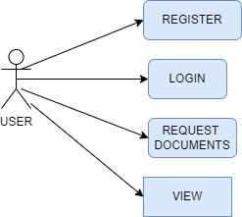
MODULE DIAGRAM
USE CASE DIAGRAM:

Slide 16
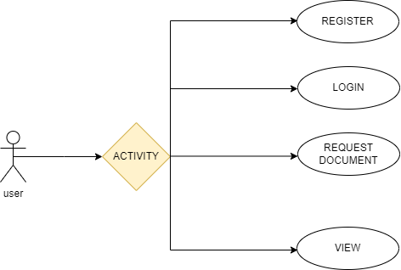
ACTIVITY DIAGRAM

Slide 17
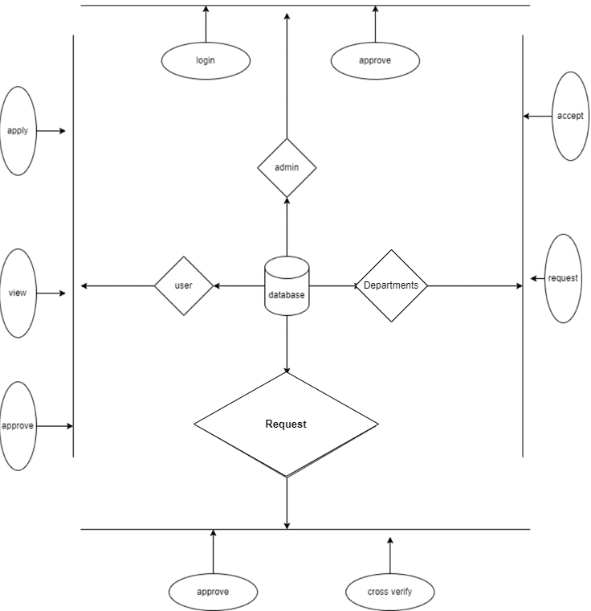
E-R DIAGRAM:

Slide 18
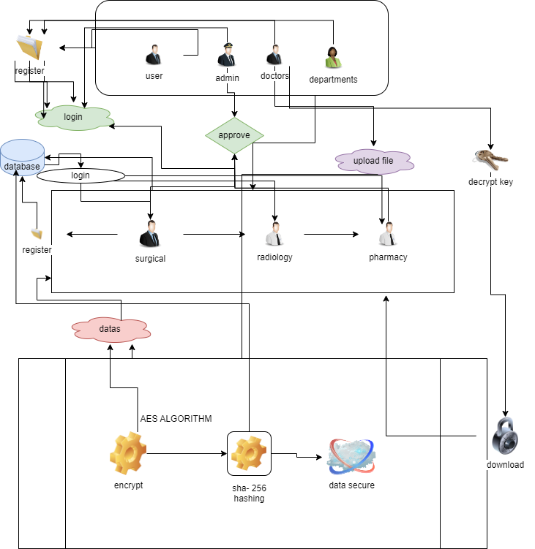

SYSTEM ARCHITECTURE
view

Slide 19
CODINGS:
<!DOCTYPE html>
<html lang="en" xmlns:th="http://www.thymeleaf.org">
<head>
<meta charset="UTF-8">
<meta name="viewport" content="width=device-width, initial-scale=1.0">
<title>Welcome | Doctors</title>
<link href="https://cdn.jsdelivr.net/npm/bootstrap@5.0.2/dist/css/bootstrap.min.css" rel="stylesheet" integrity="sha384-EVSTQN3/azprG1Anm3QDgpJLIm9Nao0Yz1ztcQTwFspd3yD65VohhpuuCOmLASjC" crossorigin="anonymous">
<script src="https://cdn.jsdelivr.net/npm/bootstrap@5.0.2/dist/js/bootstrap.bundle.min.js" integrity="sha384-MrcW6ZMFYlzcLA8Nl+NtUVF0sA7MsXsP1UyJoMp4YLEuNSfAP+JcXn/tWtIaxVXM" crossorigin="anonymous"></script>
<link rel="shortcut icon" href="C:\Users\saura\Downloads\fabicon-removebg-preview (2).png">
<body>

Slide 20
<header>
<div class="motto"><b>Welcome</b></div>
<div class="slideshow">
<img src="https://encrypted-tbn0.gstatic.com/images?q=tbn:ANd9GcRdji1931PbuaaeOzkiWxZwCP0Y-l4Xi1WwR1sD38DAMHght4-40fDGDgm8uf3LQa0zNBU&usqp=CAU" alt="Image 1">
<img src="https://t3.ftcdn.net/jpg/05/65/55/96/360_F_565559600_YuYjetRZf0xO4hEzElmYPtWXI7bdpXeE.jpg" alt="Image 2">
<img src="https://plus.unsplash.com/premium_photo-1674841252366-162fc9b8f983?q=80&w=1887&auto=format&fit=crop&ixlib=rb-4.0.3&ixid=M3wxMjA3fDB8MHxwaG90by1wYWdlfHx8fGVufDB8fHx8fA%3D%3D" alt="Image 3">
<img src="https://plus.unsplash.com/premium_photo-1673351534430-f5dde7d87a60?q=80&w=2002&auto=format&fit=crop&ixlib=rb-4.0.3&ixid=M3wxMjA3fDB8MHxwaG90by1wYWdlfHx8fGVufDB8fHx8fA%3D%3D" alt="Image 4">
<img src="https://plus.unsplash.com/premium_photo-1682141160157-d6a296a65574?q=80&w=1932&auto=format&fit=crop&ixlib=rb-4.0.3&ixid=M3wxMjA3fDB8MHxwaG90by1wYWdlfHx8fGVufDB8fHx8fA%3D%3D" alt="Image 5">
<img src="https://plus.unsplash.com/premium_photo-1674499074438-8f611a3569f6?q=80&w=2069&auto=format&fit=crop&ixlib=rb-4.0.3&ixid=M3wxMjA3fDB8MHxwaG90by1wYWdlfHx8fGVufDB8fHx8fA%3D%3D"

Slide 21
<img src="https://images.unsplash.com/photo-1505751172876-fa1923c5c528?q=80&w=2070&auto=format&fit=crop&ixlib=rb-4.0.3&ixid=M3wxMjA3fDB8MHxwaG90by1wYWdlfHx8fGVufDB8fHx8fA%3D%3D" alt="Image 9">
<img src="https://images.unsplash.com/photo-1578496479763-c21c718af028?q=80&w=2070&auto=format&fit=crop&ixlib=rb-4.0.3&ixid=M3wxMjA3fDB8MHxwaG90by1wYWdlfHx8fGVufDB8fHx8fA%3D%3D" alt="Image 10">
<img src="https://images.unsplash.com/photo-1543333995-a78aea2eee50?q=80&w=2070&auto=format&fit=crop&ixlib=rb-4.0.3&ixid=M3wxMjA3fDB8MHxwaG90by1wYWdlfHx8fGVufDB8fHx8fA%3D%3D" alt="Image 11">
<img src="https://images.unsplash.com/photo-1582560469781-1965b9af903d?q=80&w=1993&auto=format&fit=crop&ixlib=rb-4.0.3&ixid=M3wxMjA3fDB8MHxwaG90by1wYWdlfHx8fGVufDB8fHx8fA%3D%3D" alt="Image 12">
<img src="https://plus.unsplash.com/premium_photo-1661779616524-1825ac40c9d6?q=80&w=2070&auto=format&fit=crop&ixlib=rb-4.0.3&ixid=M3wxMjA3fDB8MHxwaG90by1wYWdlfHx8fGVufDB8fHx8fA%3D%3D" alt="Image 13">
</div>
<style>

Slide 22
body {
font-family: Arial, sans-serif;
background-color: #f5f5f5;
color: #333;
margin: 0;
padding: 0;
}
/* Header */
header {
position: relative;
overflow: hidden;
width: 100%;
height: 400px; /* Adjust height as needed */
display: flex;
justify-content: center;
align-items: center;
}

Slide 23
.slideshow img {
width: 25%;
height: auto;
object-fit: cover;
}
@keyframes slideImages {
0% {
transform: translateX(0%);
}
100% {
transform: translateX(-100%);
}
}
.logo {
position: relative;
top: 20px;
left: 10px;

Slide 24
.logo img {
width: 400px; /* Adjust the width of the logo */
height: auto;
filter: brightness(150%); /* Increase brightness for better visibility */
}
.motto {
position: absolute;
bottom: 20px;
left: 50%;
transform: translateX(-50%);
z-index: 1;
color: #FFA500; /* Adjust color for better visibility */
font-size: 24px; /* Increase font size for better visibility */
}
/* Navigation */

Slide 25
.main-content {
padding: 20px;
display: flex;
justify-content: space-between;
align-items: center;
flex-wrap: wrap;
}
.main-content .left-column {
flex: 1;
max-width: 50%;
padding-right: 20px;
}
.main-content .right-column {
flex: 1;
max-width: 50%;
padding-left: 20px;

Slide 26
.services h2 {
text-align: center;
margin-bottom: 20px;
}
.service-container {
display: flex;
justify-content: space-between;
align-items: flex-start;
}
.service {
flex: 1;
margin: 0 10px;
background-color: #fff;
border-radius: 8px;
box-shadow: 0 0 20px rgba(0, 0, 0, 0.1);
overflow: hidden;
}
.service-info {

Slide 27
.service h3 {
margin-bottom: 10px;
color: #333;
}
.service p {
margin-bottom: 20px;
color: #666;
}
.btn {
display: block;
text-align: center;
background-color: #333;
color: #fff;
text-decoration: none;
padding: 10px 20px;
border-radius: 5px;
transition: background-color 0.3s ease;
}

Slide 28
patient-reviews h2 {
margin-bottom: 10px;
text-align: center;
}
.review {
display: flex;
align-items: center;
padding: 15px;
border-bottom: 1px solid #ddd;
}
.review img {
width: 100px;
height: 100px;
border-radius: 50%;
margin-right: 20px;
}
.review-content {
flex: 1;

Slide 29
/* Footer */
footer {
background-color: #333;
color: #fff;
text-align: center;
padding: 10px 0;
}
/* Founders Section Styles */
.founders {
background-color: #f9f9f9; /* Background color similar to other sections */
color: #333; /* Text color similar to other sections */
padding: 50px 0;
text-align: center;

Slide 30
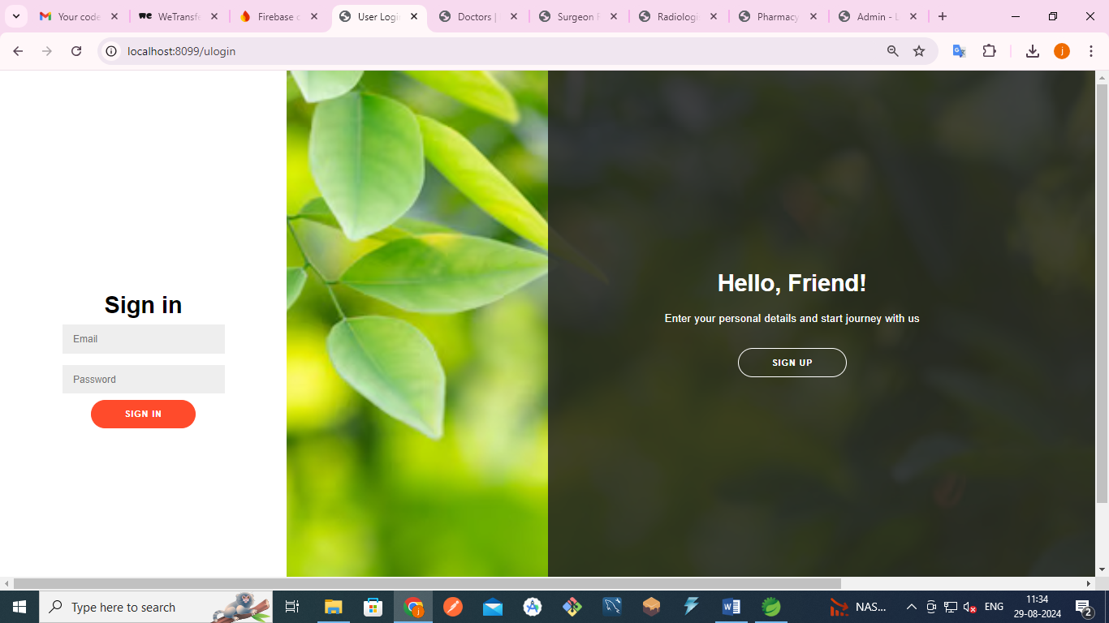
SNAPSHOTS:

Slide 31
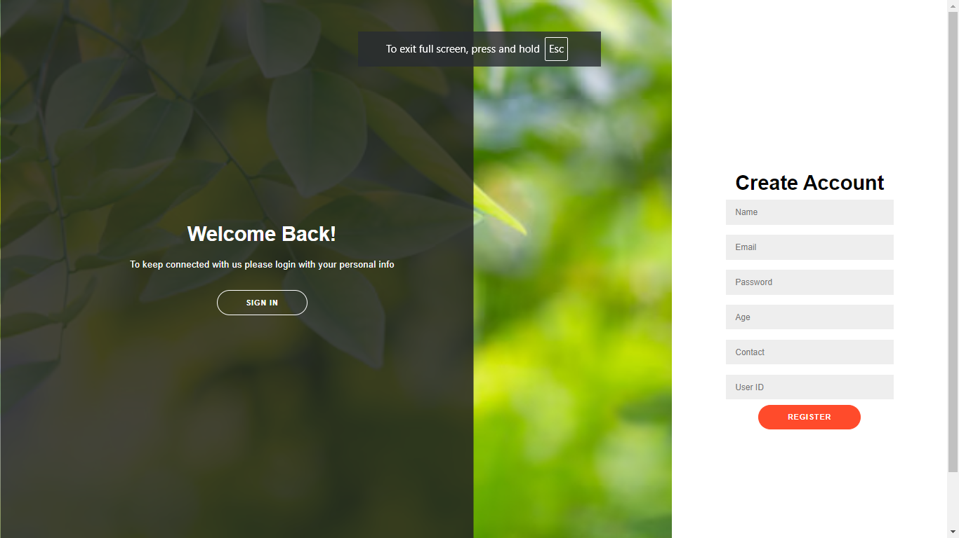

Slide 32
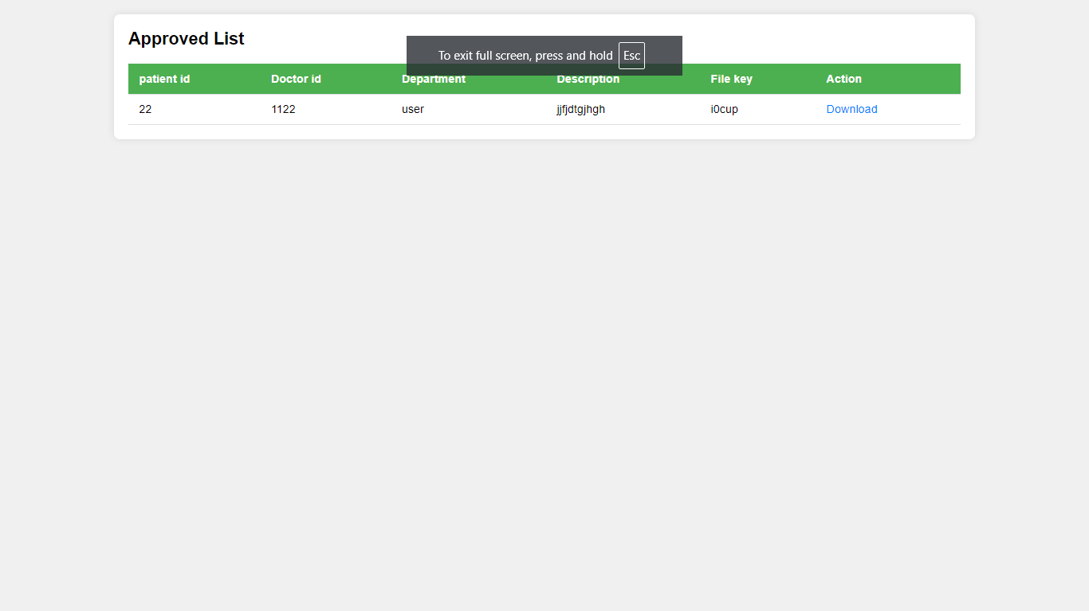

Slide 33
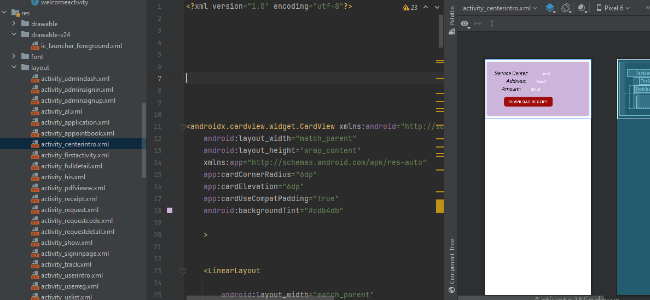

Slide 34
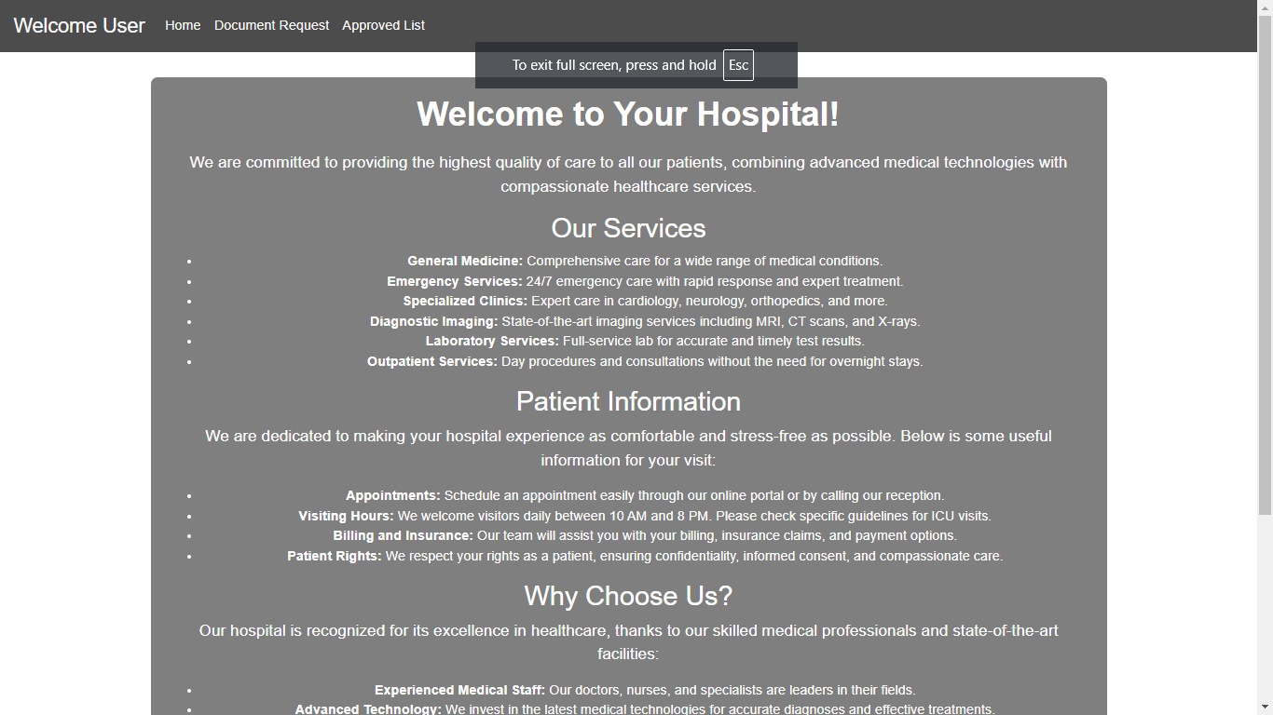

Slide 35
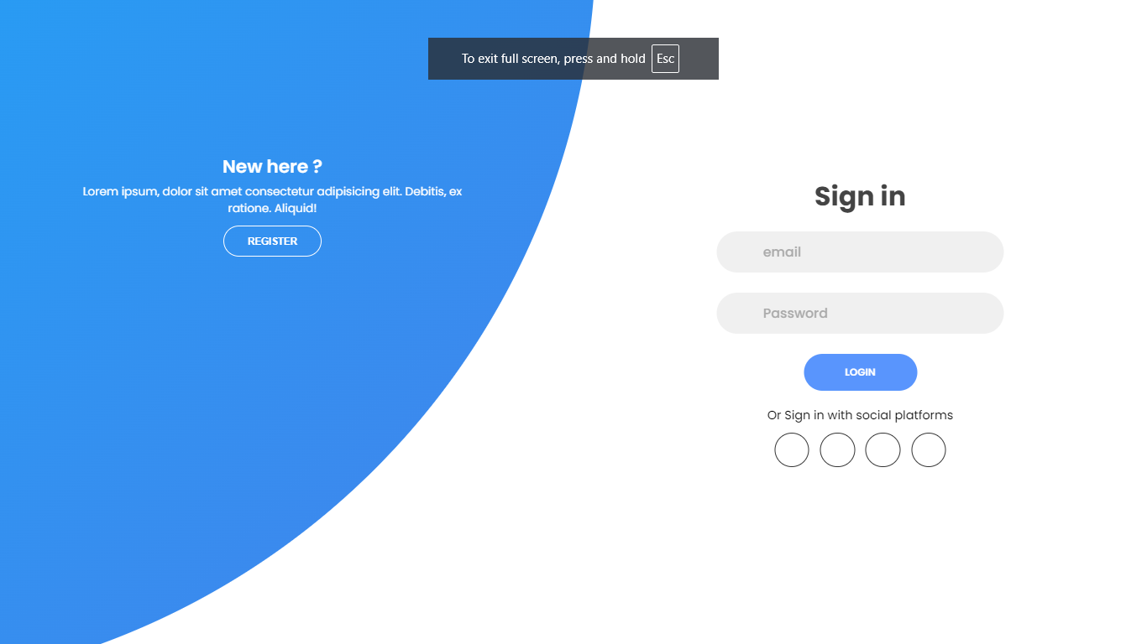

Slide 36
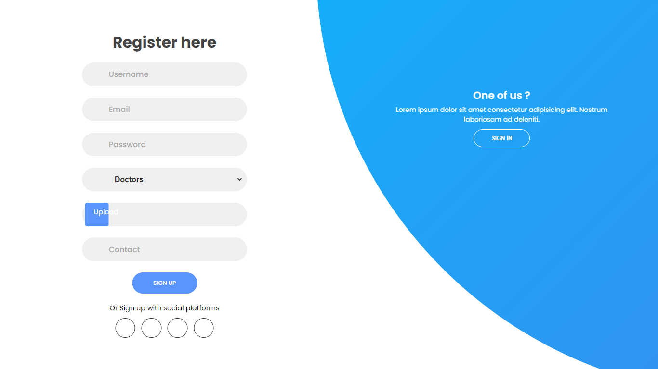

Slide 37
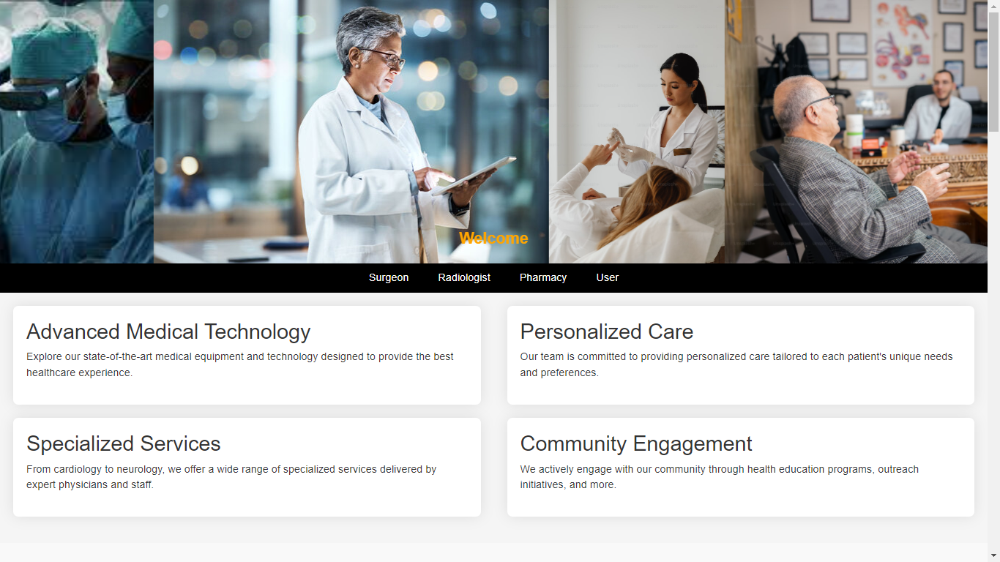

Slide 38
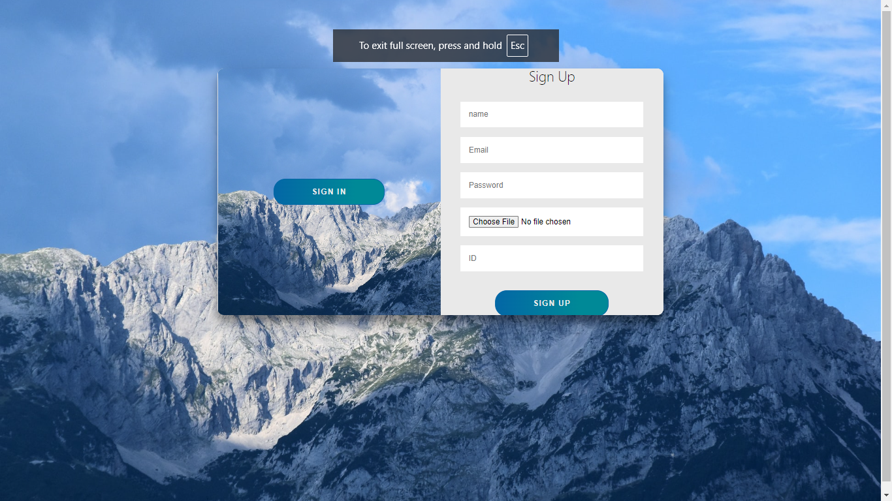

Slide 39
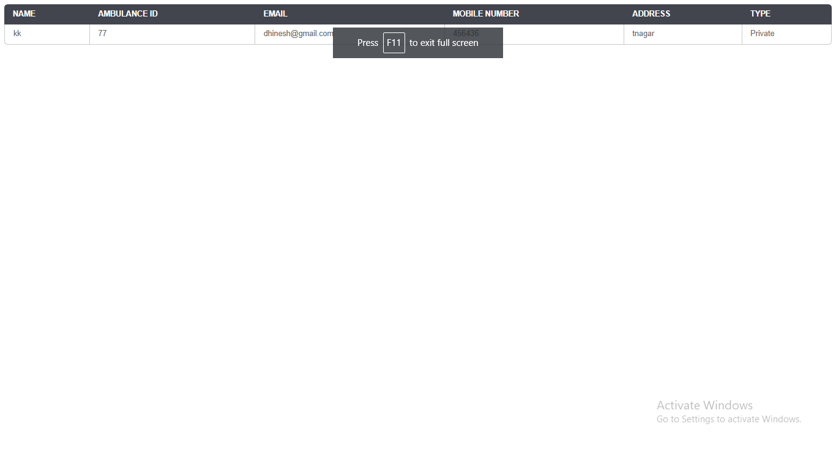

Slide 40
FUTURE ENHANCEMENT:
To further improve and scale the system, the following future enhancements can be considered:
AI Integration: Incorporate artificial intelligence for predictive analytics and intelligent diagnostics using the securely stored patient data.
IoT Device Integration: Enable real-time data collection from wearable and implantable health monitoring devices, with blockchain ensuring data authenticity.
Interoperability Standards: Adopt emerging healthcare data standards such as HL7 FHIR to support broader system compatibility.
Decentralized Identity (DID): Implement blockchain-based patient identification systems for more secure and portable digital health identities.

Slide 41
Scalability Improvements: Use Layer-2 blockchain solutions or sidechains to enhance transaction throughput and reduce latency.
Mobile Application: Develop a user-friendly mobile app for patients and doctors to access and manage records with biometric authentication.
Smart Health Cards: Introduce blockchain-enabled health cards that carry patient credentials and medical history for emergency access.

Slide 42
CONCLUSION:
In summary, your project integrates blockchain technology to enhance the integrity and confidentiality of patient data within a healthcare system. The system involves multiple roles, including client specialists, radiologists, surgeons, pharmacists, and administrators, each with specific responsibilities and access rights. After a patient registers and logs in, they receive a unique encrypted number from their specialist, which is then forwarded to various departments such as surgery, radiology, and pharmacy. This unique number ensures that sensitive patient information is protected and cannot be misused. The blockchain framework guarantees data integrity by providing an immutable ledger, while encryption and a structured endorsement process safeguard patient confidentiality. This approach not only streamlines data handling across different departments but also builds a secure and reliable system that fosters trust and efficiency in patient care.

Slide 43
REFERENCES:
1. M. A. Ferrag, M. Derdour, M. Mukherjee, A. Derhab, L. Maglaras, and H. Janicke, "Blockchain Technologies for the Internet of Things: Research Issues and Challenges," IEEE Internet of Things Journal, vol. 6, no. 2, pp. 2188–2204, Apr. 2019.
2. S. Nakamoto, "Bitcoin: A Peer-to-Peer Electronic Cash System," 2008. [Online]. Available: https://bitcoin.org/bitcoin.pdf
S. B. Zanjal and G. R. Teli, "Medical Records Management Using Blockchain Technology," 2019 3rd International Conference on Computing Methodologies and Communication (ICCMC), pp. 1135–1139, 2019.
4. X. Yue, H. Wang, D. Jin, M. Li, and W. Jiang, "Healthcare Data Gateways: Found Healthcare Intelligence on Blockchain with Novel Privacy Risk Control," Journal of Medical Systems, vol. 40, no. 10, Oct. 2016.
5. M. Mettler, "Blockchain technology in healthcare: The revolution starts here," 2016 IEEE 18th International Conference on e-Health Networking, Applications and Services (Healthcom), pp. 1–3, 2016.

Slide 44
6. A. Azaria, A. Ekblaw, T. Vieira, and A. Lippman, "MedRec: Using Blockchain for Medical Data Access and Permission Management," 2016 2nd International Conference on Open and Big Data (OBD), pp. 25–30, 2016.
7. L. Fan et al., "A Blockchain-Based Privacy-Preserving Scheme for Large-Scale Health Data," IEEE Access, vol. 8, pp. 101073–101086, 2020.
8. S. P. R. K. Chaurasia, "Blockchain for Healthcare Data Security: State of the Art and Future Trends," International Journal of Medical Informatics, vol. 166, pp. 104876, 2023.
9. N. Kumar, V. N. S. S. R. S. S. Reddy, and R. S. Chouhan, "Recent Advances in Blockchain-Based Healthcare Systems and Data Privacy," Future Generation Computer Systems, vol. 130, pp. 307–325, 2023.
10. D. O. Adeyemo and A. A. Alaba, "Blockchain-Based Approaches for Secure Health Data Management," Journal of Healthcare Engineering, vol. 2023, Article ID 7261990, 2023.

